Slide 1
NS2- Simulation 1 Design

Slide 2
Network Topology
The components present in the desired topology are
Source #1
Source #2
Router #1
Router #2
Receiver #1
Receiver #2

Slide 3
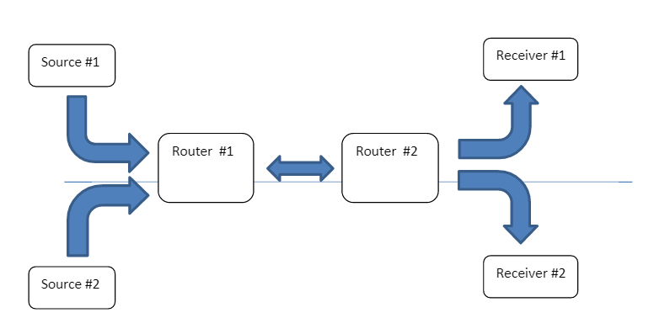
Topology Diagram:

Slide 4
Topology Description
Duplex Links have to be set up between the various nodes and using the specified end-to-end delays
TCP agents have to be created and attached to the two sources.
A FTP generating traffic has to made to function over TCP
A function record can be used to calculate the number of bytes received by the TCP Sink
The throughput is measured in Mbit/sec

Slide 5
Measurement Metrics
TCP Throughput and RTT
Measure the variation of the two parameters with respect to each other

Slide 6
New Record()
Proc record{}
Global tcpsink1 tcpsink2 and other global parameters
Set ns[Simulator instance]
Set time <time>
Set bw0 [$tcpsink1 set bytes_]
Set bw1 [$tcpsink2 set bytes_]
Get the current time using “set now command”

Slide 7
Calculate Bandwidth in record()
Set sum1[expr $sum1+$bw0/$time*8/1000000]
Set sum2[expr $sum2+$bw1/$time*8/1000000]
Output measurements and ratio in file
E.g: set ratio[expr $sum1/$sum2]
And puts $file1 "Ratio of RTT delay: [expr $ratio]"

Slide 8
Reschedule record() again
Reset the counters
Reschedule:
$ns at [expr $now+$time] “record”

